Slide 1


Lecture 2-7 Message-Based Integration and Enterprise Service Bus Reading: Text Chapter 8 Sections 8.5
CSE446 / CSE598 Software Integration and Engineering
Unit 2 Software Development by Composition and Integration
Dr. Yinong Chen

Slide 2
Outline of the Lecture
Text Chapter 8 Sections 8.5
Message-Based Integration
Java Message Service
Microsoft Message Queue
Creating Your Own Messaging Services
Enterprise Service Bus (ESB)
IBM ESB
Oracle ESB
Progress Sonic ESB

Slide 3
Synchronous and Asynchronous Communication
System integrations we discussed so far are based on point-to-point communication, either in the form of synchronous mode or asynchronous mode.
Synchronous communication requires to establish a connection and to complete the communication within the connection. Analogy: Phone call
Asynchronous one-way or two-way communication is more flexible. However, the message receiver is required to be available at the time when the communication starts. Analogy: Phone call with a call back or a second call.
What happen if the receiver is offline?
Messaging

Slide 4
Need for Messaging System
Message-based communication, or messaging, is asynchronous, but it takes the asynchronous communication a step further.
It does not require the receiver to be available (online) at the time the communication starts.
The messages can be queued (buffered) and delivered when the receiver becomes available.
Analogy: text message, email, and discussion board.
Messaging requires a queuing mechanism to store the messages

Slide 5
Communication Patterns
Messaging systems, also referred to as Messaging Oriented Middleware (MOM), is a critical and widely used communication platform for enterprise applications and application integration.
A messaging system is mainly used for supporting
asynchronous one-way messages with an independent storage,
message board for publishing-subscription and one-to-many messages.
The system normally also includes other communication patterns, such as synchronous as well synchronous two-way messages;

Slide 6
A Messaging System
Server Storage and Management

Slide 7
JMS: Java Message Service
http://www.oracle.com/technetwork/java/jms/index.html
https://jcp.org/en/jsr/detail?id=343
JMS API is a messaging standard that allows application components based on the Java 2 Platform and Java Enterprise Edition (J2EE) to create, send, receive, and read messages.
It enables distributed communication that is loosely coupled, reliable, and asynchronous.
An administrator will first create JMS providers and destination objects for message queue or subscribing topics, and register them in the JNDI (Java Naming and Directory Interface).
A client registers to a queue, creates a context object, uses the context object to look up the connection factory name and to create connection, session, a destination of queue for point-to-point messaging or a destination of topic (for publish-subscribe).

Slide 8
Creating a Queue and Sending a Message
http://docs.jboss.org/jbossmessaging/docs/guide-1.0.1.SP5/html/examples.html
Sender
Administrator Created Destination Object
Receiver
Find destination queue name in JNDI
Define conn pattern
String myQueueName = getDestinationJNDIName();
InitialContext myIc = new InitialContext(); //creating an initial object
ConnectionFactory MyCf = myIc.lookup("/ConnectionFactory");
Queue myQ = (Queue) myIc.lookup(myQueueName);
Connection sendConn = MyCf.createConnection();
Session mySession = sendConn.createSession(false, Session.AUTO_ACKNOWLEDGE);
MessageProducer myMp = mySession.createProducer(myQ);
TextMessage myMsg = mySession.createTextMessage("Hello!");
myMp.send(myMsg);
Create Q
Create connection and session
Create producer & message
Send

Slide 9
Retrieve Message From a Queue
Sender
Administrator Created and Registered Queues
Receiver
Find destination queue name in JNDI
Define conn pattern
String myQueueName = getDestinationJNDIName();
InitialContext myIc = new InitialContext();
ConnectionFactory MyCf = myIc.lookup("/ConnectionFactory");
Queue myQ = (Queue) myIc.lookup(myQueueName);
Connection recvConn = MyCf.createConnection();
Session mySession = recvConn.createSession(false, Session.AUTO_ACKNOWLEDGE);
MessageConsumer myMc = mySession.createConsumer(myQ);
recvConn.start(); // start the connection
message = (TextMessage)consumer.receive(2000);
// wait certain time
Create Q
Create connection and session
Create consumer & message
Receive

Slide 10
Send Message to a Topic Board
Sender
Administrator Created and Registered Board
Receiver
Find or create
topic
String myTopicName = getDestinationJNDIName();
InitialContext myIc = new InitialContext(); // creating an initial object
ConnectionFactory MyCf = myIc.lookup("/ConnectionFactory");
Topic myTopic = (Topic) myIc.lookup(/myTopicName);
Connection myConn = MyCf.createConnection();
Session mySession = myConn.createSession(false, Session.AUTO_ACKNOWLEDGE);
MessageProducer myPub = mySession.createProducer(myTopic);
TextMessage myMsg = mySession.createTextMessage("Hello!");
myPub.send(myMsg)

Slide 11
Subscript and Listen to Message Board
Sender
Administrator Created and Registered Board
Receiver
MessageConsumer subscriber = session.createConsumer(topic);
ExampleListener myListener = new ExampleListener();
subscriber.setMessageListener(myListener);
myConn.start();
myListener.waitForMessage();
myMsg = (TextMessage)myListener.getMessage();

Slide 12
Microsoft Message Queue: System.Messaging
http://msdn.microsoft.com/en-us/library/xes6983c.aspx
In .Net Framework, the System.Messaging namespace provides classes that allow you to create, connect to, monitor, and administer message queues on the network and send, receive, or peek messages.
MessageQueueInstaller class allows the administrator to install and configure a queue. This class is called by the installation utility on the message server, for example, InstallUtil.exe. When installing a MessageQueue, a global queue on the server is created. Only one queue needs to be installed among all the partner applications.
MessageQueue class provides a local queue that access and coordinate with the server (global) queue on a Message Queuing server.

Slide 13
MessageQueue Class
MessageQueue class supports two types of message retrieval: synchronous and asynchronous.
The synchronous methods, Peek and Receive, cause the process thread to wait a specified time interval for a new message to arrive in the queue. Notice here is about “receive” operation only.
The asynchronous methods, BeginPeek and BeginReceive, allow the main application tasks to continue in a separate thread until a message arrives in the local queue. These methods work by using both callback objects and state objects to communicate information between threads.
You create a new instance of the MessageQueue class in your program, and you send a message to the server queue to associate your local queue with the server queue.

Slide 14
Example: Sending and Receiving Msg
http://msdn.microsoft.com/en-us/library/system.messaging.messagequeue.aspx
using System; using System.Messaging; // namespace MyProject {
public class Order { public int orderId; public DateTime orderTime; };
public class MyNewQueue { // Provides a container class.
public static void Main() {
// Create a new instance of the class.
MyNewQueue myNewQueue = new MyNewQueue();
// Send a message to associate this queue to a server queue.
myNewQueue.SendPublic();
// Now, access the queue by sending and receiving messages
myNewQueue.SendMessage();
// Receive a message from a queue.
myNewQueue.ReceiveMessage(); return;
}
public void SendPublic() {
MessageQueue myQueue = new MessageQueue(".\\myQueue");
myQueue.Send("Public queue by path name."); return;
} // continued next page
Create a local queue
Link to the server queue
Link to the server queue

Slide 15
Example: Send a Structured Order Object
Message Queue can also send and received a structured object.
public void SendMessage() { // Sends an Order to a queue.
// Create a new order and a set values.
Order sentOrder = new Order();
sentOrder.orderId = 3;
sentOrder.orderTime = DateTime.Now;
// Create a queue on the local computer.
MessageQueue myQueue = new MessageQueue(".\\myQueue");
// Send the Order to the queue.
myQueue.Send(sentOrder);
return;
}
// continued next page
Create an order
Link to the server queue
Send to the server queue

Slide 16
Example: Receive s Structured Order Object
Link to the server queue
public void ReceiveMessage() {
// Connect to the a queue on the local computer.
MessageQueue myQueue = new MessageQueue(".\\myQueue");
// Set the formatter to indicate body contains an Order.
myQueue.Formatter = new XmlMessageFormatter(new Type[]
{typeof(MyProject.Order)});
Try { // Receive and format the message.
Message myMessage = myQueue.Receive();
Order myOrder = (Order)myMessage.Body;
Console.WriteLine("Order ID: "+myOrder.orderId.ToString());
Console.WriteLine("Sent: "+myOrder.orderTime.ToString());
}
catch (MessageQueueException) {
} // Handle invalid serialization format.
catch (InvalidOperationException e){ Console.WriteLine(e.Message); }
return;
} }
Receive from server queue
Cast message to order

Slide 17
Creating Your Own Message Queue
Using a database
Using an XML file
Using an email account as the message queue

Slide 18
Creating Your Own Message Queue
Without using JMS or MSMQ, you can create your own message queue as a service, e.g., a .svc service);
You need a disk file (database, text file, XML file, etc.) to store the message;
Interface File
// IService.cs
[ServiceContract]
public interface Iservice {
[OperationContract]
void SendMessage(string sendUser, string Username, string Message);
[OperationContract]
string[ ] ReceiveMessage(string UserID);
}

Slide 19
Creating Your Own Message Queue: Service File
using System.Web.Services; using System.Data.SqlClient; using System.Data;
public class Service : IService {
public void SendMessage(string sendUser, string Username, string Message)
{
DBContextDataContext myDB = new DBContextDataContext();
MsgBoard myMsg = new MsgBoard();
myMsg.Username = Username;
myMsg.Message = Message;
myMsg.SendUser = sendUser;
try {
myDB.MsgBoards.InsertOnSubmit(myMsg);
myDB.SubmitChanges();
return;
}
catch (Exception) {
return;
}
}
Create a message
Send message to server DB

Slide 20
Creating Your Own Message Queue: Service File
public string[] ReceiveMessage(string UserID) {
DBContextDataContext myContext = new DBContextDataContext();
string[] strValue;
Person myPerson = myContext.Persons.SingleOrDefault(m=>m.Username == UserID);
if (myPerson != null) {
var myMsg = (from msg in myContext.MsgBoards
join msgIM in myContext.Persons on msg.Username equals msgIM.Username
where msg.Username == UserID
where msg.MsgID > msgIM.IM
orderby msg.MsgID
select msg).ToList();
if (myMsg.Count() > 0) {
int i = 0;
try {
strValue = new string[myMsg.Count()];
foreach (MsgBoard msg in myMsg) {
strValue[i] = msg.SendUser+": "+msg.Message;
i++;
} // continued next page
The user is registered
Read all messages in the database
Choose messages by user ID
To discuss in Unit 4
Read all new messages
Add all senders+messages into return array

Slide 21
Creating Your Own Message Queue: Service File
Remember the last downloaded messages
myPerson.IM = myMsg.Last().MsgID;
myContext.SubmitChanges();
}
catch (Exception) {strValue = new string[0];}
}
else {strValue = new string[0];} // return default message: no new message
}
else { // The user is not registered, who can still retrieve the msg to the userID
var _myMsg = (from msg in myContext.MsgBoards
where msg.Username == UserID
orderby msg.MsgID
select msg).ToList();
if (_myMsg.Count()>0) {
int i = 0;
strValue = new string[_myMsg.Count()];
foreach (MsgBoard msg in _myMsg) {
strValue[i] = msg.SendUser + ": " + msg.Message;
i++;
}

Slide 22
Creating Your Own Message Queue: Service File
myPerson = new Person(); // Create a new user
myPerson.Username = UserID; // Register the user
myPerson.IM = _myMsg.Last().MsgID; // Set last read message
myContext.Persons.InsertOnSubmit(myPerson); // Save the new user
myContext.SubmitChanges(); // update database
}
else
{
strValue = null;
}
}
return strValue;
}
}

Slide 23
Creating Message Queue Using XML File
http://neptune.fulton.ad.asu.edu/WSRepository/Services/Messenger/Service.svc
// IService.cs The Interface File (Remain Unchanged)
[ServiceContract]
public interface Iservice {
[OperationContract]
void SendMessage(string sendUser, string Username, string Message);
[OperationContract]
string[ ] ReceiveMessage(string UserID);
}
// Service.svc.cs The implementation file changes to XML implementation
public void SendMessage(string sendUser, string Username, string Message) {
// Please read follow the example given in text Chapter 5, Section 5.4.2
}
public string[] ReceiveMessage(string UserID) {
// Please read follow the example given in text Chapter 5, Section 5.4.2
}

Slide 24
public string[] receiveMessage(string receiverID)
public class MessagingService : Iservice {
string XMLLocale = Path.Combine(HttpRuntime.AppDomainAppPath, @"App_Data\Messages.xml");
public string[] receiveMessage(string receiverID){
string[] returnMsg;
XDocument xmlDocMsgs = XDocument.Load(XMLLocale);
XNamespace nameSpace = "http://example.com/Messages";
IEnumerable<XElement> queryElementItems =
from item in xmlDocMsgs.Root.Descendants(nameSpace + "Message")
where item.Element(nameSpace + "ReceiverID").Value == receiverID
orderby (DateTime)item.Element(nameSpace + "TS") descending
select item;
returnMsg = new string[queryElementItems.Count() * 3];
int iter = 0;
foreach (XElement item in queryElementItems) {
returnMsg[iter++] = item.Element(nameSpace + "SenderID").Value;
returnMsg[iter++] = item.Element(nameSpace + "TS").Value;
returnMsg[iter++] = item.Element(nameSpace + "MessageContents").Value;
}
return returnMsg;
}

Slide 25
public void sendMessages(string senderID, string receiverID, string message)
http://neptune.fulton.ad.asu.edu/WSRepository/Services/Messenger/Service.svc
public void sendMessages(string senderID, string receiverID, string message) {
XDocument xmlDocMsgs = new XDocument();
XNamespace nameSpace = "http://example.com/Messages";
try {
xmlDocMsgs = XDocument.Load(XMLLocale);
XElement xmlElement = new XElement(nameSpace + "Message",
new XElement(nameSpace + "SenderID", senderID),
new XElement(nameSpace + "ReceiverID", receiverID),
new XElement(nameSpace + "TS", System.DateTime.Now.ToString()),
new XElement(nameSpace + "MessageContents", message));
xmlDocMsgs.Element(nameSpace + "Messages").Add(xmlElement);
xmlDocMsgs.Save(XMLLocale);
}
catch (XmlException ex) {
if (!(ex.Message.ToLower().Contains("root") && ex.Message.ToLower().Contains("element") && ex.Message.ToLower().Contains("not") && ex.Message.ToLower().Contains("found"))) {
xmlDocMsgs = new XDocument(
new XDeclaration("1.0", "UTF-8", "yes"),
new XComment("CSE446 Messaging System Example"),
new XElement(nameSpace + "Messages",
new XElement(nameSpace + "Message",
new XElement(nameSpace + "SenderID", senderID),
new XElement(nameSpace + "ReceiverID", receiverID),
new XElement(nameSpace + "TS", System.DateTime.Now.ToString()),
new XElement(nameSpace + "MessageContents", message))));
xmlDocMsgs.Save(XMLLocale);
}}}
Please read Text Chapter 5 or Chapter 10 for XML processing methods.

Slide 26
Creating Your Own Message Queue
Using a database
Using an XML file
Using an email account as the message queue

Slide 27
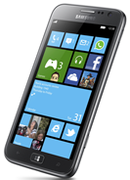
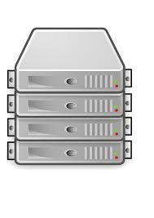
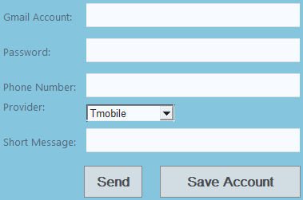

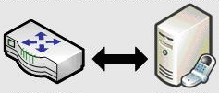
Using Short Messaging Service as Message Queue
SMS Service in ASU Service Repository
Gmail SMTP Service
SMS Gate Service
Web Application
Carrier Provider SMTP Service

Slide 28
ASU SMS Service
http://neptune.fulton.ad.asu.edu/WSRepository/Services/SMS_Service/Service.svc?wsdl
Service Operation in the ASU SMS service:
public bool SMS(string Gmail_Account, string Password, string Phone, CARRIER Provider, string Message);
- Gmail_Account : sender’s Gmail account
- Password: sender’s Gmail password
- Phone: receiver’s cellular number
- Provider: carrier provider of the cell phone number (e.g. AT&T, Sprint, TMobile, Verizon)
- Message: SMS message

Slide 29
Carrier Provider Email Extension Supporting SMS
TMobile
phone_number@tmomail.net
Sprint
phone_number@messaging.sprintpcs.com
Verizon
phone_number@vtext.com
AT&T
phone_number@txt.att.net

Slide 30
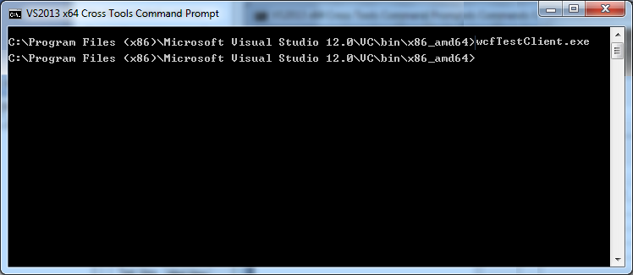
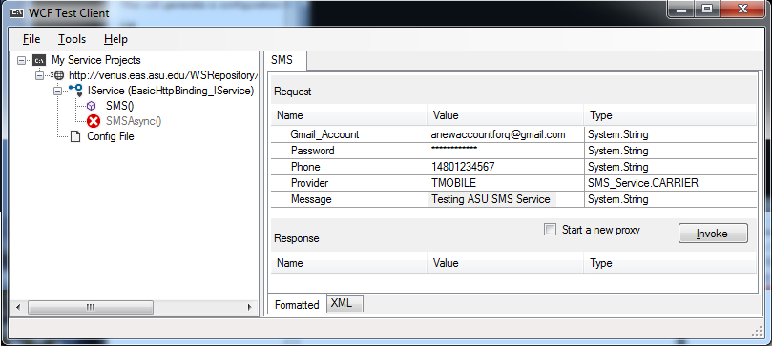
Testing ASU SMS Service Using WCF Test Client
Note: The Gmail SMTP server requires a secure connection and
you need to open a new account for the purpose.

Slide 31
Outline of the Lecture
Text section 8.5
Message-Based Integration
Java Message Service
Microsoft Message Queue
Creating Your Own Messaging Service
Using SMS as Service Queue
Enterprise Service Bus (ESB)
IBM ESB
Oracle ESB
Progress Sonic ESB

Slide 32
Software Bus ORB: Object Request Broker
CORBA: Common Object Request Broker Architecture
Distributed Objects
IDL
Stub
IDL
Stub
IDL
Stub
IDL
Stub
Object Request Broker
(Software Bus)
Object Request Broker
(Software Bus)
Network

Slide 33
Enterprise Service Bus (ESB)
Shifting from Distributed Object Orientation to Service Orientation
Enterprise Service Bus (ESB) is an industry standard for implementing messaging systems and for heterogeneous application integration.
ESB provides an abstraction layer on top of an implementation of an enterprise messaging system;
It allows integration architects to exploit the value of messaging without writing code.
It is the service-oriented version of ORB.
Contrary to the more classical Enterprise Application Integration (EAI) approach (tightly coupled), ESB provides a loosely coupled platform to support distributed functions, with distributed (independent) deployment where needed, while still working in harmony.

Slide 34
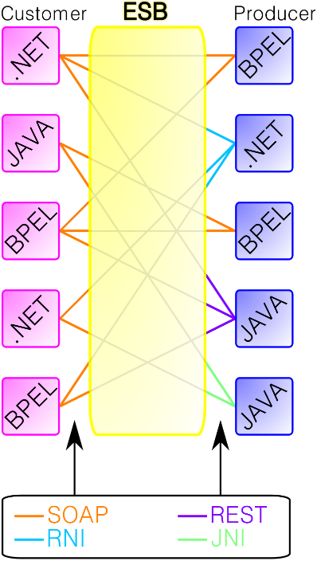
Key Features of ESB
Buffer messages for off-line delivery;
Translate message formats;
Adapt different interaction patterns;
Convert transport protocols;
Analyze and share the service interface;
Dynamic selection of a service to handle a request
Location transparency
Propagate the security content;
Provide WS-* support, including WS-RM, WS-Security, and WS-Transaction;
Track and monitor service activities.
https://en.wikipedia.org/wiki/Enterprise_service_bus

Slide 35
Different Implementations of ESB Standard
ESB has been implemented by different vendors, including:
IBM WebSphere ESB (http://www-01.ibm.com/software/integration/wsesb/),
Oracle ESB in Oracle SOA Suite (http://download.oracle.com/docs/cd/E12524_01/doc.1013/e12638/esb_intro.htm),
Microsoft BizTalk ESB (http://www.microsoft.com/biztalk/en/us/esb-guidance.aspx),
Progress Sonic ESB (http://web.progress.com/en/sonic/sonic-esb.html),
Fiorano ESB, which is a part of Fiorano’s cloud computing environment (http://www.fiorano.com/products/ESB-enterprise-service-bus/),
SAP ESB.

Slide 36
IBM View: Modeling Business in SOA
This is your current business model …
… into this (SOA).
Depository
Vendor Setup
Vendor
Process Servers
Banks
Customer Perceived
Application
Service
Application
Service
Application
Service
Application
Service
Budget
Maintenance
(Imaging)
NEW Soundscan
Shows
VAN
Universal Account
In-Stock
Analysis Tool
Printer
S20-Sales
Mesa Data
Reconcilliation
Maintenance
Polling
I13- Auto
Hand Scan
Printer PO
Customer
Replenishment
Apps
Reports
Insertions
Sales
Order
Due Dates
Calendar
Orders
Print Costing
Corrections
Warehouse
Broadcast
General
Invoice App
Management
Stores & Mrkts
Filter
Maintenance
Interface
PO
Smart Plus
Millennuim 3.0
Smart Plus
Sales Posting
Launcher
Cell
Return to
Tally Sheet
Millennium
Phones
D01 Post Load
Vendor
Credit App
Stock Options
Employee
Equifax
Billing
Solution
Satellite
Resource
Change Notice
A04 - Cust
Software
System
-Promo
Scheduling
On-line New
Refund Chks
DFK
1
Analysis
Interface
Interface
Interface
Resumix
Hire Entry
P01-
AAS
Price
Employee
Marketing
Cobra
P09 - P17
Masterfile
Support
Bus Systems
Cyb.
ABC
website
- ISP
CTS
Co
Home
Cycle Physical
Tracking
ACH
Prodigy
V04-Sign
Deliveries
Inventory
Banks - ACH and Pos to
POS
System
CTO
-
Pay
Transfers
Host to AS400
Plan Administrators
Communication
(401K, PCS, Life)
Spec Source
Stock
SKU Tracking
Status
Counts
Price
Testing
Supplier
Employee
Intercept
Sales
Scanning
Layaways
Compliance
Purchase
Tax
Spec
PO
Scorecard
Source
Receiving
SKU
Mkt
Performance
Bonus/HR
Reactions
Polling
Price Management
Inventory Info
Coop
SKU Selection
DRK
System
Customer Repair
Tool
ABBX
Tracking
I35 Early Warning
Planning
Rebate
SKU Rep
System
Store
Transfer
SKU
Purchase
Monitor
PowerSuite
General
Information
Order
Ad Expense
Ledger
Store
Tex A
Sign
Scorecard
System
N.
Count Corrections
Store Budget
Interface
Interface
Interface
Interface
Tx
Writer
Merchandise
Media
Reporting
Workspace
Analysis
BMP - Bus
EDI
performance Mngt
Mngr Approval
Coordinator
Batch Forcasting
AIMS
AP
Journal Entry Tool Kit
Ad Measurement
Cellular
INVENTORY CONTROL APPS - PC
INVENTORY CONTROL APPS - PC
ACCTS REC APPS - PC
Ad
AIMS
Rollover
OTHER APPS - PC
Launcher
Reporting
House
PSP
Op.
Recon
Charges
Capital
File
Data Warehouse
In-Home
Projects
SS
Connect 3
Credit
Repair
Connect 3
Connect 3
Cash Receipts/Credit
Application
Service
Application
Service
Application
Service
Application
Service
Fixed
PDF Transfe
Reports
Misc Accounting/Finance Apps - PC/NT
Warranty
Assets
Billing
Repair
Cash Over/
System
Short
Rich business abstractions describe the application interface
Decouples the interfaces from the business applications
The number and complexity of the interfaces are reduced
Business applications and their interfaces become reusable
Source: IBM Carter Sandy Keynote Presentation 2005
Notes:
So how does web services decouple the interfaces from their applications?
1) It uses a programming model that allows a rich abstraction of both the business app and the interface.
2) By abstracting the interfaces, they can be clearly separated from the business applications.
3) This enables you to reduce the number and complexity of those interfaces and.
4) It allows you to reuse both the interfaces and the business applications.
The problem is that you still have to build, find, and manage all of those interfaces somewhere.

Slide 37
The ESB shrinks those interfaces further
Turn this (SOA) …
… into this (ESB-based SOA)
Application
Service
Application
Service
Application
Service
Application
Service
Application
Service
Application
Service
Application
Service
Application
Service
Interface
Interface
Interface
Enterprise Service Bus
Interface
Interface
Interface
Interface
Application
Service
Application
Service
Application
Service
Application
Service
Application
Service
Application
Service
Application
Service
Application
Service
Decouples the point-to-point connections from the interfaces
Allows for dynamic selection, substitution, and matching
Enables more flexible coupling and decoupling of the applications
Enables you to find both the applications and the interfaces for reuse
Source: IBM Carter Sandy Keynote Presentation 2005
Notes:
The ESB shrinks the interfaces further.
1) It virtualizes the interface, or in other words, it decouples the point-to-point connections from the interfaces themselves.
2) The interfaces are put into a third party broker which helps you manage the interfaces better.
3) The enables faster and more flexible coupling and decoupling of applications.
4) Because you can find all of the applications and the interfaces, you can then reuse both.

Slide 38
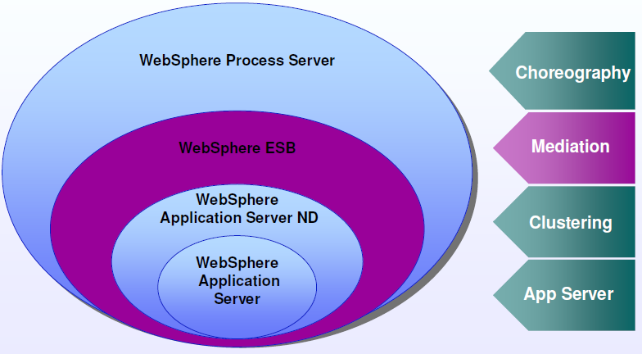
IBM WebSphere Server Hierarchy

Slide 39

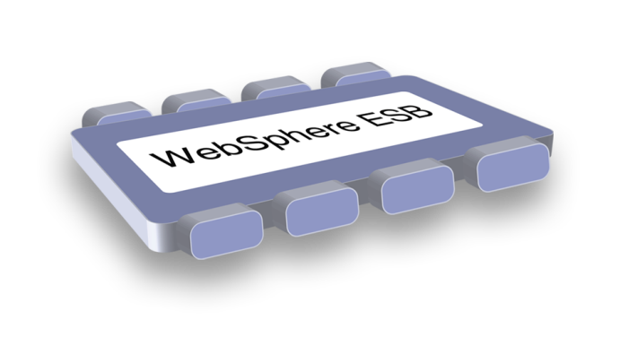
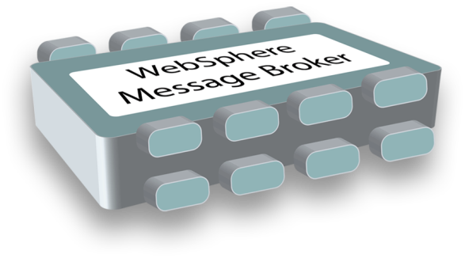

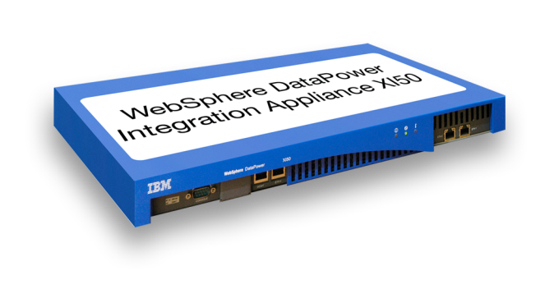
ESB Components from IBM WebSphere:
WebSphere ESB Built on WebSphere Application Server for an integrated SOA platform
WebSphere Message Broker
Built for universal connectivity and transformation in heterogeneous IT environments
WebSphere DataPower Integration Appliance
Purpose-built hardware ESB for simplified deployment and hardened security

Slide 40
ESB: Leverage the SOA Reference Architecture
WebSphere Data Power
WebSphere ESB
Business Services
Supports enterprise business process and goals through businesses functional service
WebSphere Message Broker
Interaction Services
Process Services
Information
WebSphere Transformation Extender
Development Services
Enables collaboration between people, processes & information
Orchestrate and automate business processes
Manages diverse data and content in a unified manner
WebSphere Service Registry & Repository
Integrated environment for design and creation of solution assets
Enterprise Service Bus
Management Services
Business App Services
Access Services
Partner Services
Apps &
Info Assets
Connect with trading partners
Build on a robust, scalable, and secure services environment
Facilitate interactions with existing information and application assets
Manage and secure services, applications & resources
Infrastructure Services
Optimizes throughput, availability and utilization

Slide 41
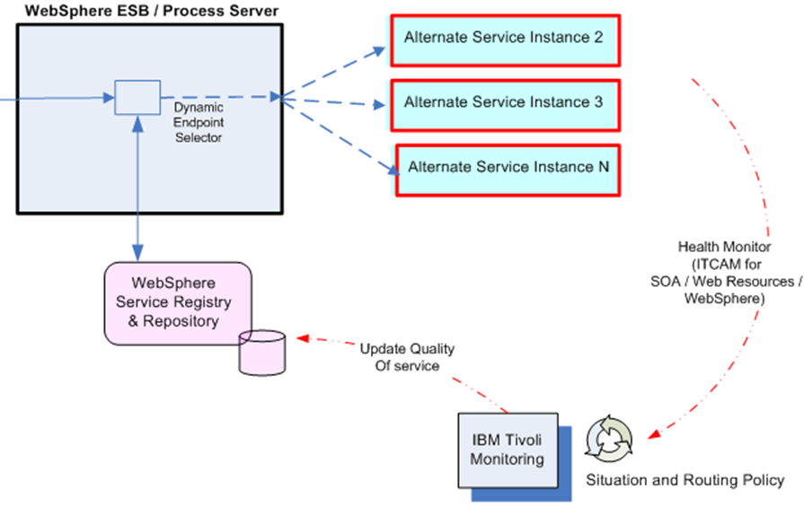
Dynamic Service Binding Using IBM ESB
Service Consumer

Slide 42
Integrating Heterogeneous Applications
Send coordinate information
(simulate sensors)
BEA
AquaLogic
ESB
IBM
Message Broker
ESB
MQ
NCO Demo
BEA Application
Server
Display Coordinate Information via ESRI map portlet
JMS
Sensor
Application
Message
Flows
DB
MQ
BEA to MQ
Message
Flow
Display
Application
Mediations
CSV to XML
Content XForm
Publish Event
Display Coordinate Information via Google Maps
XMS
(Coordinate data)
C Application
MQ
TCP
On Ramp
Message
Flow
C Application
TCPIP
(Coordinate data)
CSV to XML
Content XForm
Publish Event

Slide 43
ESB Federation: Connecting Multiple ESBs
User
interaction
channels
Operations
Call center
Internet Web site
Business
processes
New employee
Browse product catalog
Book-to-bill
Business
services
Establish employee accounts
ESB
ESB
ESB
PBX access
Reserve inventory
Prepare shipment
Credit scoring
Billing
Data
services
Employee data mgmt
ESB
Customer data mgmt
Inventory
data mgmt
Part-time
employee
data
Full-time
employee
data
Legacy billing systems
System
services
Security event log
Security
profile
Customer
“master”
database
Web site
customer
database
COTS Sales App
Product
catalog
ESB
Existing
inventory
application
AD
LDAP
Source: Forrester Research 2008

Slide 44
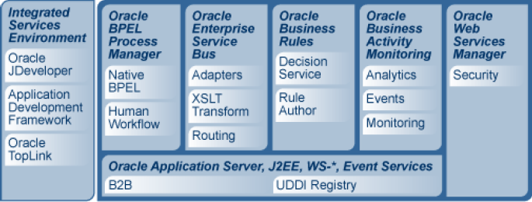
Oracle SOA Suite Architecture
http://www.oracle.com/technetwork/middleware/service-bus/overview/oracle-30.pdf

Slide 45


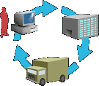




Evolution of the Oracle Service Bus
SOAP/HTTP/ Reliable SOAP
Proprietary Message Bus
JMS and SOAP
OEMS, JMS, MQ, TIBCO
Local, In Memory, Fastpath
CRM (Customer Relationship Management)
ERP (Enterprise Resource Planning)
B2B
WSDL
WSDL
WSDL
WSDL
WSDL
Design
Monitoring
WSDL
WSDL
WSDL
Legacy
Portal
.NET

Slide 46
Oracle ESB – Core Features
Deliver Information
to the Right Place,
at the Right Time
in the Right Format
Rich Set of Adapters (technology and applications)
Transformation
Reliable Message Delivery
Content-based Routing
Publish and Subscribe
Service URL Virtualization
Enterprise Service Bus
SOAP
JCA
In Memory
JMS
B2B
JAX
SAP
Java
Main
frame
Trading
Partner

Slide 47
Oracle ESB Federation and Topology
File
Fulfillment
UDDI
JCA
Binding
Database
ESB
Server 1
ESB
Server 2
ESB
Node 1
SAP
HTTP
Binding
MDS 2
Headquarters
ESB
Server 3
JMS
Router
Oracle
HTTP
Binding
JCA
Binding
Web Service Manager
MDS 1
JMS
Binding
JMS
Router
JMS
Binding
Siebel
Customer Service
ESB
Server 1
ESB
Server 1
ESB
Server 2
MDS 3
Web Service Manager
ESB
Server 3
MQ
Binding
Mainframe

Slide 48
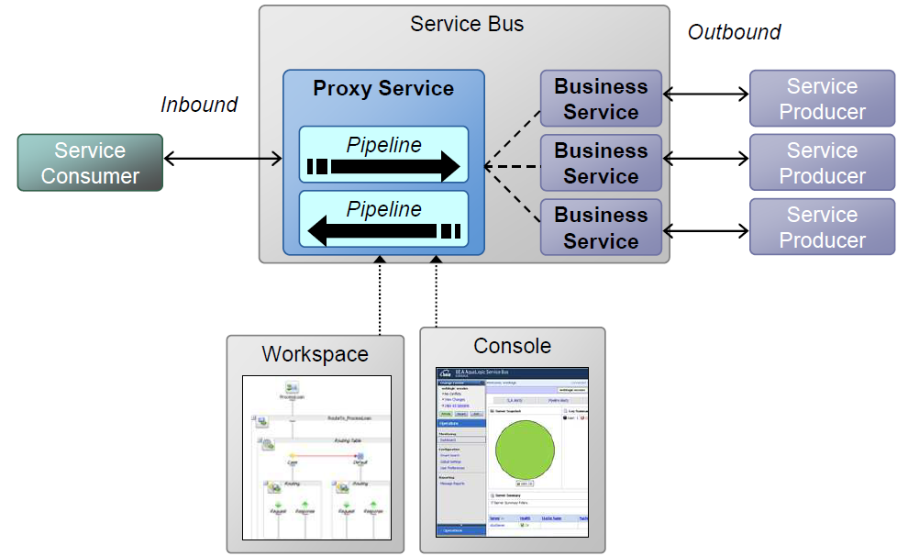
Proxy Services in Service Bus
Protocols Supported
• SOAP over HTTP/JMS
• HTTP/S
• JMS
• RMI/IIOP (EJB)
• Tuxedo, MQSeries
• Email (SMTP/POP/IMAP)
• FTP/Secure FTP
• Custom
• Oracle Adapters (framework + Adapters post 10gR3)
Message Formats
XML
Text
Custom Binary (EDI, etc.)

Slide 49
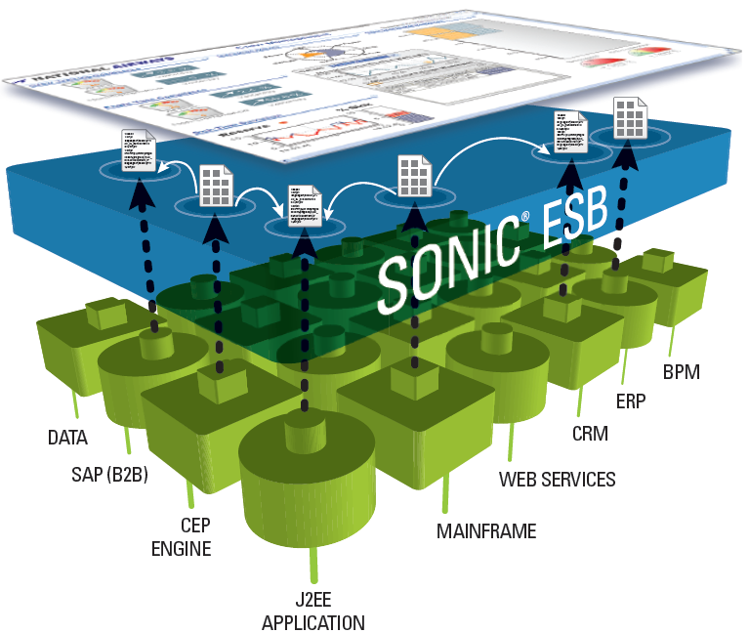
Progress Sonic ESB
Frontend
Backend

Slide 50
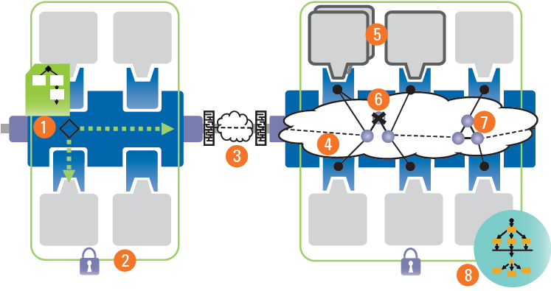
Progress Sonic ESB Features
Intelligent routing: provides highly-scalable, end-to-end control of event flow across distributed environments.
Integrate across security domains: The Sonic ESB spans security domains to form a federated environment.
Across the firewall: Provides secure, reliable communications even over high-latency Internet, satellite, or dial-up connections.
The Dynamic Routing Architecture® (DRA) automatically routes cross-cluster messages.
Scale services: Services may be dynamically added to meet changing throughput demands.
Continuous Availability Architecture (CAA) – Fault Tolerance.
Clustered communication brokers: Communication backbone throughput can be dynamically scaled by adding brokers at runtime; no service re-configuration is required.
BPEL Server: Improves developer productivity by enabling service composition and event correlation with minimal programming.

